Slide 1
UPPER SIXTH ARTS
GEOGRAPHY
Practical Work 3
Material Index, Location Triangles and Isodapanes
Notes:
Good morning, class, and welcome to our geography lesson. I am your geography teacher, Mr Kamdem. Today we are starting Practical Work 3: Material Index, Location Triangles and Isodapanes.

Slide 2
CLASS INFO
Class, Chapter and Duration
Class | Upper Sixth Arts
Chapter | Module 6: Understanding and managing the dynamics of economic activities across the world in general and Cameroon in particular
Duration | 2 periods (2 × 50 minutes)
Notes:
This lesson is for Upper Sixth Arts. It belongs to Module 6: Understanding and managing the dynamics of economic activities across the world in general and Cameroon in particular. We shall need 2 periods to cover it.

Slide 3
IDENTIFICATION
Lesson Identification
Topic | Theories of Industrial Location
Sub-topic | Theories of Industrial Location
Lesson | Practical Work 3: Material Index, Location Triangles and Isodapanes
Notions / Concepts | Material index, location triangle, ton-kilometres, isodapane, critical isodapane.
Syllabus focus | Calculation of material index and location types; location triangles; plotting and interpreting isodapanes and least labour cost location.
Competence | Learners are able to calculate the material index and use isodapanes.
Notes:
Our topic is Theories of Industrial Location, and the sub-topic is Theories of Industrial Location. The key notions we shall use today are: material index, location triangle, ton-kilometres, isodapane, critical isodapane. At the end, you should be able to do this: learners are able to calculate the material index and use isodapanes.

Slide 4

HOMEWORK CORRECTION
Correction of the Homework
Question (Lesson 23: Weber's Least-Cost Model):
Calculate the MI of two industries and state their best location.
Notes:
Before we start the new lesson, let us correct the homework I gave you at the end of Lesson 23: Weber's Least-Cost Model. The question was: Calculate the MI of two industries and state their best location. Take out your exercise books.

Slide 5
HOMEWORK CORRECTION
Correction: Possible Answer
Sugar: MI = 8 ÷ 1 = 8 → locate near the cane fields (Mbandjock). Brewing: MI = 0.2 ÷ 1 = 0.2 → locate near the market (Douala, Yaoundé).
Notes:
Here is a good answer. Sugar: MI = 8 ÷ 1 = 8 → locate near the cane fields (Mbandjock). Brewing: MI = 0.2 ÷ 1 = 0.2 → locate near the market (Douala, Yaoundé). Compare it with your own answer and correct your work in red.

Slide 6
LESSON PLAN
Lesson Plan
Correction of the homework
Objectives and recall
Real-life situation and action to take
Learning activities
Board summary
Evaluation, remediation and homework
Notes:
Here is the plan of our lesson today. First, we shall correct the homework. Then we shall look at the objectives and recall what you already know. After that, we shall study a situation from real life and the action to take, and do the learning activities. Finally, we shall copy the board summary, do the evaluation and the remediation, and I will give you the homework.

Slide 7
OBJECTIVES
Objectives
By the end of this lesson, you should be able to:
Calculate the material index.
Find the least transport cost point in a triangle.
Notes:
Take your time to copy this part; we will continue together.

Slide 8
OBJECTIVES
Objectives (continued)
Interpret isodapanes for a labour location.
Notes:
By the end of this lesson, you should be able to do three things. Number 1: calculate the material index. Number 2: find the least transport cost point in a triangle. Number 3: interpret isodapanes for a labour location.

Slide 9
PREVIOUS KNOWLEDGE
Previous Knowledge
MI = materials ÷ product.
Isodapanes join equal extra transport costs.
Notes:
Let us first remember what you already know. MI = materials ÷ product. Isodapanes join equal extra transport costs. Keep this in mind, because we shall build on it today.

Slide 10
REAL-LIFE SITUATION
Situation in Real Life
An investor wants to build a cement factory. It needs 1.6 t of limestone and 0.2 t of gypsum for each tonne of cement. The class must advise where to build.
Notes:
Listen carefully to this situation from real life. An investor wants to build a cement factory. It needs 1.6 t of limestone and 0.2 t of gypsum for each tonne of cement. The class must advise where to build. Think about it, because I am going to ask you some questions.

Slide 11
REAL-LIFE SITUATION
Situation: Question 1
What is the problem in the situation?
Notes:
Question 1: What is the problem in the situation? Think for a moment, then raise your hand to answer.

Slide 12
REAL-LIFE SITUATION
Answer
The class must find the best factory location.
Notes:
Good. The class must find the best factory location.

Slide 13
REAL-LIFE SITUATION
Situation: Question 2
What must they calculate first?
Notes:
Question 2: What must they calculate first? Think for a moment, then raise your hand to answer.

Slide 14
REAL-LIFE SITUATION
Answer
The material index.
Notes:
Good. The material index.

Slide 15
REAL-LIFE SITUATION
Situation: Question 3
What is MI here?
Notes:
Question 3: What is MI here? Think for a moment, then raise your hand to answer.

Slide 16
REAL-LIFE SITUATION
Possible Answer
(1.6 + 0.2) ÷ 1 = 1.8, so near the limestone.
Notes:
Good. (1.6 + 0.2) ÷ 1 = 1.8, so near the limestone.

Slide 17
ACTION TO TAKE
Action to Take
Calculate the least-cost location of an industry.
Notes:
From this situation, the action we are working towards in this lesson is the following: calculate the least-cost location of an industry.

Slide 18
JUSTIFICATION
Justification of the Lesson
This practical work helps us to apply Weber's model with numbers.
Notes:
Why is this lesson important for you? This practical work helps us to apply Weber's model with numbers.

Slide 19
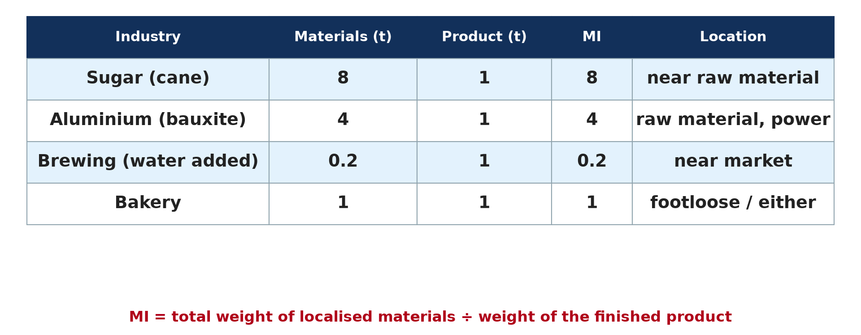
1. MATERIAL INDEX
Activity 1
Material index of several industries.
Notes:
Activity 1. Look carefully at this diagram: material index of several industries. Observe every detail before I ask the question.

Slide 20
1. MATERIAL INDEX
Activity 1: Question
Why is brewing market-oriented?
Notes:
Here is the question for Activity 1: Why is brewing market-oriented? Take one minute to think and write your answer in your rough notebook.

Slide 21
1. MATERIAL INDEX
Activity 1: Answer
MI = 0.2: water is added at the market, so the product gains weight.
Notes:
Let us check the answer together. MI = 0.2: water is added at the market, so the product gains weight.

Slide 22

2. LOCATION TRIANGLES: TON-KILOMETRES
Activity 2
A location triangle.
Notes:
Activity 2. Look carefully at this diagram: a location triangle. Observe every detail before I ask the question.

Slide 23
2. LOCATION TRIANGLES: TON-KILOMETRES
Activity 2: Question
A site is 20 km from 2 t of ore and 10 km from a market for 1 t of product. Find the ton-km.
Notes:
Here is the question for Activity 2: A site is 20 km from 2 t of ore and 10 km from a market for 1 t of product. Find the ton-km. Take one minute to think and write your answer in your rough notebook.

Slide 24
2. LOCATION TRIANGLES: TON-KILOMETRES
Activity 2: Answer
2 × 20 + 1 × 10 = 50 ton-km.
Notes:
Let us check the answer together. 2 × 20 + 1 × 10 = 50 ton-km.

Slide 25
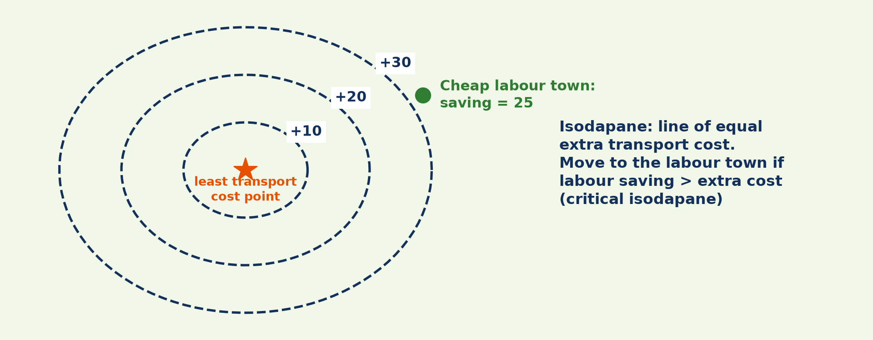
3. ISODAPANES
Activity 3
Isodapanes.
Notes:
Activity 3. Look carefully at this diagram: isodapanes. Observe every detail before I ask the question.

Slide 26
3. ISODAPANES
Activity 3: Question
The labour town saves 25 per tonne and lies between the +20 and +30 isodapanes. Should the firm move?
Notes:
Here is the question for Activity 3: The labour town saves 25 per tonne and lies between the +20 and +30 isodapanes. Should the firm move? Take one minute to think and write your answer in your rough notebook.

Slide 27
3. ISODAPANES
Activity 3: Answer
Only if the extra cost there is below 25; between +20 and +30 it depends on the exact position.
Notes:
Let us check the answer together. Only if the extra cost there is below 25; between +20 and +30 it depends on the exact position.

Slide 28

1. APPLICATION
Activity 4
A bauxite mine.
Notes:
Activity 4. Look carefully at this picture: a bauxite mine. Observe every detail before I ask the question.

Slide 29
1. APPLICATION
Activity 4: Question
Aluminium: 4 t of bauxite give 1 t of metal. Where should the refinery be?
Notes:
Here is the question for Activity 4: Aluminium: 4 t of bauxite give 1 t of metal. Where should the refinery be? Take one minute to think and write your answer in your rough notebook.

Slide 30
1. APPLICATION
Activity 4: Answer
MI = 4, so near the bauxite (if power is available).
Notes:
Let us check the answer together. MI = 4, so near the bauxite (if power is available).

Slide 31

4. INTERPRETATION
Activity 5
Location factors.
Notes:
Activity 5. Look carefully at this diagram: location factors. Observe every detail before I ask the question.

Slide 32
4. INTERPRETATION
Activity 5: Question
Why may real factories not follow the calculation?
Notes:
Here is the question for Activity 5: Why may real factories not follow the calculation? Take one minute to think and write your answer in your rough notebook.

Slide 33
4. INTERPRETATION
Activity 5: Answer
Power, labour, government and markets also matter.
Notes:
Let us check the answer together. Power, labour, government and markets also matter.

Slide 34
BOARD SUMMARY
Board Summary
Topic: Theories of Industrial Location
Sub-topic: Theories of Industrial Location
Practical Work 3: Material Index, Location Triangles and Isodapanes
Notes:
Now we are going to copy the board summary. Write the title and the headings neatly in your notebooks. I will give you enough time for each slide, so do not rush.

Slide 35
BOARD SUMMARY
DEFINITIONS
The key terms of this lesson are defined as follows:
Ton-kilometre: It is the transport of one tonne over one kilometre.
Isodapane: It is a line joining places of equal extra transport cost.
Notes:
Let us copy the definitions. The key terms of this lesson are defined as follows. On this slide we have Ton-kilometre and Isodapane. Write each point on a new line, with the key term first, and explain it in your own words when we revise.

Slide 36
BOARD SUMMARY
1. Material Index and Location Triangles
The calculations are done as follows:
Material index: MI = weight of localised materials ÷ weight of product. Aluminium: 4 t of bauxite give 1 t of metal, so MI = 4 and the smelter locates near the raw material or cheap power.
Notes:
Let us copy Material Index and Location Triangles. The calculations are done as follows. On this slide we have Material index. Write each point on a new line, with the key term first, and explain it in your own words when we revise. When you finish, we go to the next slide.

Slide 37
BOARD SUMMARY
1. Material Index and Location Triangles (continued)
Ton-kilometres: For each possible site, multiply each weight by its distance and add the results. The site with the lowest total is the least-cost location.
Notes:
We continue with Material Index and Location Triangles. On this slide we have Ton-kilometres. Write each point on a new line, with the key term first, and explain it in your own words when we revise. When you finish, we go to the next slide.

Slide 38
BOARD SUMMARY
1. Material Index and Location Triangles (continued)
Example: A site 20 km from 2 t of ore and 10 km from a market for 1 t of product: 2 × 20 + 1 × 10 = 50 ton-km. The site with the lowest total is chosen.
Notes:
We continue with Material Index and Location Triangles. On this slide we have Example. Write each point on a new line, with the key term first, and explain it in your own words when we revise.

Slide 39
BOARD SUMMARY
1. Material Index and Location Triangles
Illustration: material index of industries
Notes:
Now draw this illustration in your notebook: material index of industries. Give it a title and label it clearly.

Slide 40
BOARD SUMMARY
2. Isodapanes and Least Labour Cost
Isodapanes are plotted and interpreted as follows:
Plotting: Draw lines of equal extra transport cost around the least-cost point. Each line shows how much more it costs to locate there.
Notes:
Let us copy Isodapanes and Least Labour Cost. Isodapanes are plotted and interpreted as follows. On this slide we have Plotting. Write each point on a new line, with the key term first, and explain it in your own words when we revise. When you finish, we go to the next slide.

Slide 41
BOARD SUMMARY
2. Isodapanes and Least Labour Cost (continued)
Interpretation: If a cheap-labour town lies inside the critical isodapane (where extra cost = labour saving), the firm moves there. A saving of 25 inside the +20 line makes the move profitable.
Notes:
We continue with Isodapanes and Least Labour Cost. On this slide we have Interpretation. Write each point on a new line, with the key term first, and explain it in your own words when we revise. When you finish, we go to the next slide.

Slide 42
BOARD SUMMARY
2. Isodapanes and Least Labour Cost (continued)
Limits: Real firms consider markets, government, power and personal choice. So factories may not follow the calculation.
Notes:
We continue with Isodapanes and Least Labour Cost. On this slide we have Limits. Write each point on a new line, with the key term first, and explain it in your own words when we revise.

Slide 43
BOARD SUMMARY
2. Isodapanes and Least Labour Cost
Illustration: isodapanes
Notes:
Now draw this illustration in your notebook: isodapanes. Give it a title and label it clearly.

Slide 44
FORMATIVE EVALUATION
Evaluation 1
Cement uses 1.6 t limestone and 0.2 t gypsum per tonne. Find MI and the location.
Notes:
Now let us check what you have understood. Question 1: Cement uses 1.6 t limestone and 0.2 t gypsum per tonne. Find MI and the location. Answer in your exercise book.

Slide 45
FORMATIVE EVALUATION
Expected Answer
MI = 1.8, near the limestone.
Notes:
The expected answer is: mI = 1.8, near the limestone. If you got it right, well done.

Slide 46
FORMATIVE EVALUATION
Evaluation 2
When does a firm move to a cheap-labour site?
Notes:
Now let us check what you have understood. Question 2: When does a firm move to a cheap-labour site? Answer in your exercise book.

Slide 47
FORMATIVE EVALUATION
Expected Answer
When the site is inside the critical isodapane (savings > extra costs).
Notes:
The expected answer is: when the site is inside the critical isodapane (savings > extra costs). If you got it right, well done.

Slide 48
REMEDIATION
Remediation
Fill in the blanks:
MI = materials ÷ ______.
Moving 1 t over 1 km is one ______.
Savings equal to extra cost define the ______ isodapane.
Notes:
For those who need more practice, fill in the blanks in your exercise book. The answers are: number 1, product; number 2, ton-kilometre; number 3, critical.

Slide 49
HOMEWORK
Homework
Calculate ton-kilometres for three sites and choose the least-cost site.
Notes:
For your homework: Calculate ton-kilometres for three sites and choose the least-cost site. We shall correct it at the beginning of our next lesson.

Slide 50
NEXT LESSON
Next Lesson
Our next lesson will be on:
Lesson 24: Other Theories of Industrial Location: Lösch and Smith
Notes:
Our next lesson will be on Lesson 24: Other Theories of Industrial Location: Lösch and Smith. Thank you for your attention, and see you next time.

Slide 51
BILINGUAL GAME
Bilingual Game (Jeu Bilingue)
English | Français
Calculation | Le calcul
Site | Le site
Limestone | Le calcaire
Cement | Le ciment
Saving | L'économie
Isodapane | L'isodapane
Notes:
Let us play the bilingual game. I say a word in English, and you give me the French word. Then we do the reverse.

Slide 52
LOGBOOK
Official Logbook (1/2)
Module / Topic | Theories of Industrial Location
Lesson Title | Practical Work 3: Material Index, Location Triangles and Isodapanes
Expected Learning Outcomes | Calculate the material index. Find the least transport cost point in a triangle. Interpret isodapanes for a labour location.
Competence | Learners are able to calculate the material index and use isodapanes.
Notes:
I record this information in the official logbook of the class after the lesson.

Slide 53
LOGBOOK
Official Logbook (2/2)
Matter Taught | DEFINITIONS; Material Index and Location Triangles; Isodapanes and Least Labour Cost.
Evaluation | Formative evaluation and remediation exercise.
Homework | Calculate ton-kilometres for three sites and choose the least-cost site.
Enrolment / Present / Absent | ____ / ____ / ____
Achievement | To be completed after the lesson.
Notes:
I complete the second page of the logbook: the matter taught, the evaluation, the homework and the attendance.

Slide 54
TEACHER'S NOTE
Teacher's Note
Timing: Homework correction, plan, objectives 8 min | Recall, situation, action 10 min | 5 activities 30 min | Board summary (copying) 30 min | Evaluation, remediation 10 min | Homework, next lesson 5 min | Logbook 7 min
Without the projector (Activity 1): calculate MI for each.
Without the projector (Activity 2): compare several sites.
Without the projector (Activity 3): discuss the critical isodapane.
Without the projector (Activity 4): discuss Minim-Martap.
Without the projector (Activity 5): discuss limits.
Notes:
This slide is for me, the teacher: it gives the timing of the lesson and what to do if the projector is not available.

Slide 55
REFERENCES
References
National Geography Syllabus, MINESEC/IGE/IP-SS, 2019 — Module 6 (Economic Geography).
Photo, Activity 4: “Bauxite mine near Itea, Greece” by Jason-Morrison, CC BY-NC 2.0, via Flickr (https://www.flickr.com/photos/8998833@N07/929316608)
Diagrams and animations: drawn for this lesson (Geography Department).
Notes:
These are the references and picture credits used to prepare this lesson.

